Slide 1
Theory Of Automata
Lec 02 – Regular Expression
Instructor
Rana Marwat Hussain

Slide 2
Text and Reference Material
Introduction to Computer Theory, by Daniel I. Cohen, John Wiley and Sons, Inc., Second Edition

Slide 3
Previous Lecture
Introduction to the course title
Formal and In-formal languages
Alphabets, Strings, Words
Null string
Defining languages
Valid and In-valid alphabets
Length of a string
Reverse of a string

Slide 4
Defining Languages
Defined in different ways
Descriptive definition
Recursive definition
Regular Expressions(RE)
Finite Automaton(FA) etc.
Descriptive definition of language:
The language is defined, describing the conditions imposed on its words.

Slide 5
Example -I
The language L of strings of odd length, defined over Σ={a},
L={a, aaa, aaaaa,…..}
The language L of strings that does not start with a, defined over Σ={a,b,c}, can be written as
L={b, c, ba, bb, bc, ca, cb, cc, …}
The language L of strings of length 2, defined over Σ={0,1,2}, can be written as
L={00, 01, 02, 10, 11, 12, 20, 21, 22}
The language L of strings ending in 0, defined over Σ={0,1}, can be written as
L={0, 00,10, 000, 010, 100, 110,…}

Slide 6
Example -II
Let S={a, bb, bab, abaab} be a set of strings.
Does abbabaabab and baabbbabbaabb in S*?
Does any word in S* have odd number of b’s?
abbabaabab => (a) (bb) (abaab) ab ,
which shows that the last member of the group does not belong to S, so this string is not in S*
baabbbabbaabb =>
can not be grouped as members of S, hence this string is not in S*.
Since each string in S has even number of b’s so there is no possibility of any string with odd number of b’s to be in S*.

Slide 7
Class Activity
Is there any case when S⁺ contains Λ? If yes then justify your answer.
consider S={Λ , a} then
S⁺ ={Λ, a, aa, aaa, …}
Here Λ is in S⁺ as member of S.
Thus Λ will be in S⁺ , in this case.

Slide 8
Some Languages
PALINDROME
EVEN PALINDROME
ODD PALINDROME
EVEN
ODD
EQUAL
PRIME
EVEN EVEN

Slide 9
PALINDROME
The language consisting of Λ and the strings s defined over Σ such that reverse(s) = s.
reverse(s) = s means
reverse of the string is the same as the input string
denoted with PALINDROME.
Example:
For Σ={a,b},
PALINDROME={Λ , a, b, aa, bb, aaa, aba, bab, bbb, ...}

Slide 10
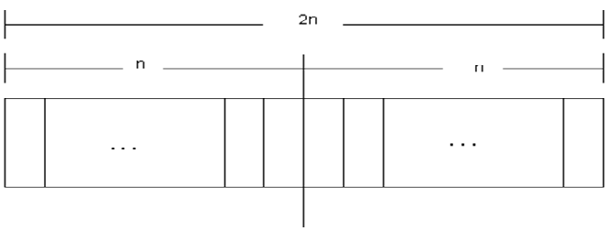
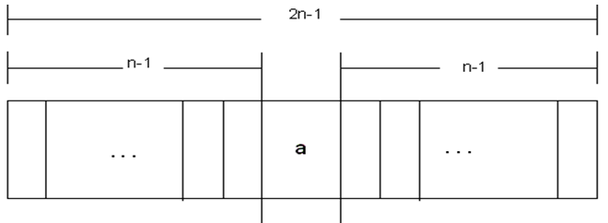
Even vs ODD PALINDROME
EVEN PALINDROME:
Palindrome having even length
saas, abba
ODD PALINDROME:
Palindrome having odd length
dad, mom, madam

Slide 11
EVEN vs ODD
The language consisting of Λ and the strings s having even length.
denoted with EVEN.
Example:
For Σ={a,b},
EVEN={Λ , aa, ab, ba , bb, aaaa, ...}
The language consisting the strings s having odd length.
denoted with ODD.
Example:
For Σ={a,b},
ODD={a,b, aaa, aab, aba, abb , baa, bab, bbb, ...}

Slide 12
EQUAL
The language consisting the strings s with number of a’s equal to number of b’s
denoted with EQUAL.
Example:
For Σ={a,b},
EQUAL={Λ ,ab, aabb, abab, baba, abba,…}

Slide 13
Prime
The language consisting the strings s having Prime length.
denoted with PRIME.
Example:
For Σ={a}, {a^{p} : p is prime},
PRIME ={aa,aaa,aaaaa,aaaaaaa,aaaaaaaaaaa…}

Slide 14
EVEN EVEN
strings with even number of a’s and even number of b’s, defined over Σ={a,b},
can be written as
{Λ, aa, bb, aaaa,aabb,abab, abba, baab, baba, bbaa, bbbb,…}

Slide 15
Regular Expression (RE)
Step 1: Every letter of Σ including Λ is a regular expression.
Step 2: If r₁ and r2 are regular expressions then
  (r₁)
  r₁ r₂
  r₁ + r₂ and
  r₁*
  are also regular expressions.
Step 3: Nothing else is a regular expression.

Slide 16
Regular Expression
All words of ‘a’ including NULL
L₁ = {Λ, a, aa, aaa, …}
a* = {Λ, a, aa, aaa, … }
All words of ‘a’ without NULL
L₂ = {a, aa, aaa, aaaa, …}
a+ = { a, aa, aaa, aaaa, …}
a* and a⁺ are the regular expressions for L₁ and L₂ respectively.
Note: a⁺, aa* and a*a generate L₂.

Slide 17
RE Examples
→ language having two words of length 1
(a+b) => L={a, b}
→language having two words of length 3 ending wih ab
(a+b) ab => L={aab, bab}
→Universal set including NULL
(a+b)* =>L={Λ, a, b, aa, ab, ba, bb, aaa, aab, …}
→Universal set without NULL
(a+b)⁺ =>L = { a, b, aa, ab, ba, bb, aaa, aab, ……}

Slide 18
RE Examples
→All words starts with ‘a’
a (a+b) * =>L={a, aa, ab, aaa, aab, aba, ab, ….}
→All words starts and ends with ‘a’
a (a+b)*a =>L={aa, aaa, aba, aaaa, aaba, abaa, abba….}
→All words starts with ‘a’ and ends with ‘b’
a (a+b) *b =>L={ab, aab, abb, aaab, aabb, abab, abbb ….}
→All words having ‘a’ and ‘b’ alternatively that starts with ’a’ and ends with ‘b’
(ab)* =>L={Λ, ab, abab, ababab, …..}

Slide 19
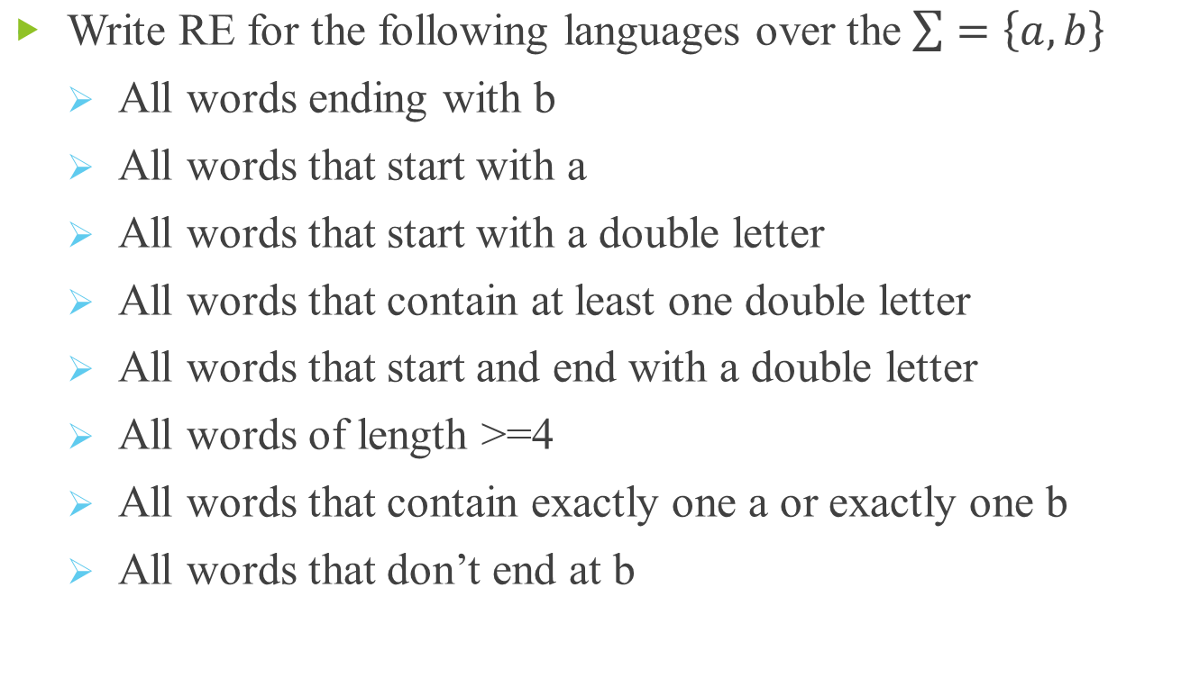
RE Examples

Slide 20
RE Examples
Language of words starting with double a and ending in double b
→ aa(a+b)*bb
Language of words starting with a and ending in b OR starting with b and ending in a
→a(a+b)*b+b(a+b)*a
Language of words having at least one a and one b
→(a+b)*a(a+b)*b(a+b)*+ (a+b)*b(a+b)*a(a+b)
Language of words not ending in a
→ (a+b)*b + Λ or ((a+b)*b)*.

Slide 21
RE Examples
Give a regular expression for each of the following over the alphabet { 0, 1 }:
  { w | w begins with a ‘1’ and ends with a ‘0’ }
  { w | w contains exactly three 1’s}
  { w | w contains at least three 1’s}
  { w | w is a string that begin with a ‘1’ and contain exactly two 0’s }
Regular expression definition of a language is not unique.

Slide 22
RE – Class Activity
Write regular expressions for:
1. {w in {a,b}* | |w| is odd }.
2. {w in {a,b}* | w does not have ab as a substring}.
3. {w in {a,b,c}* | no b in w can come before any c in w}.

Slide 23
Homework:
Ch-4 Problems: 2-11, 15-18

